Slide 1
Cloud Computing Lab
Mini Project
Janvi Mehta TE - B (2010)
Mitali Mohite TE - B (20102119)
Tejas Mestry TE - B (2010)

Slide 2
NewsGrid
The collection point of world news

Slide 3
Cloud Services Used
EC2 - Elastic Compute Cloud
IAM - Identity and Access Management
RDS - Relational Database Service

Slide 4
EC2
IAM
Virtualization
We have used EC2 to host our web application, allowing businesses to easily scale compute resources up or down as needed based on website traffic.
We have used IAM for Access Control, to give roles and policy conditions and we can also use it for multi factor authentication
We have used Virtualization to allow multiple virtual machines (VMs) to run on a single physical server, enabling efficient use of hardware resources and flexibility in managing server capacity.

Slide 5
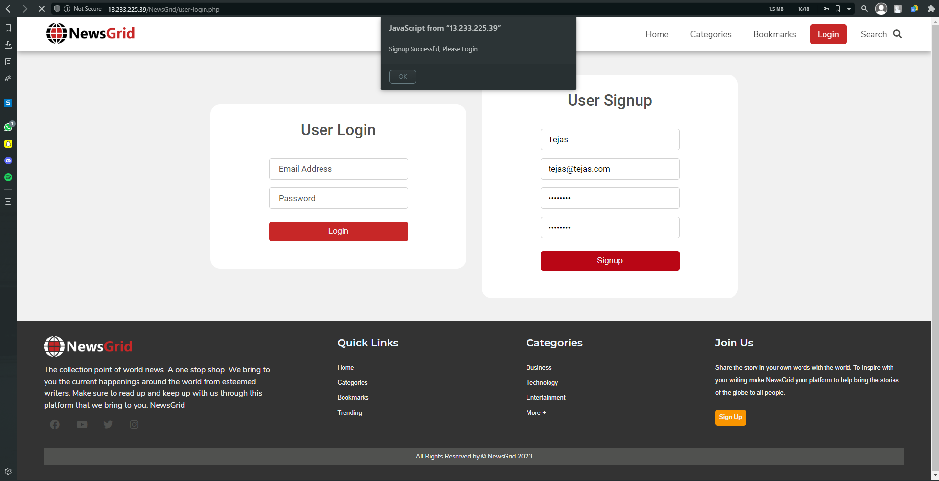
Login/Registration Page

Slide 6
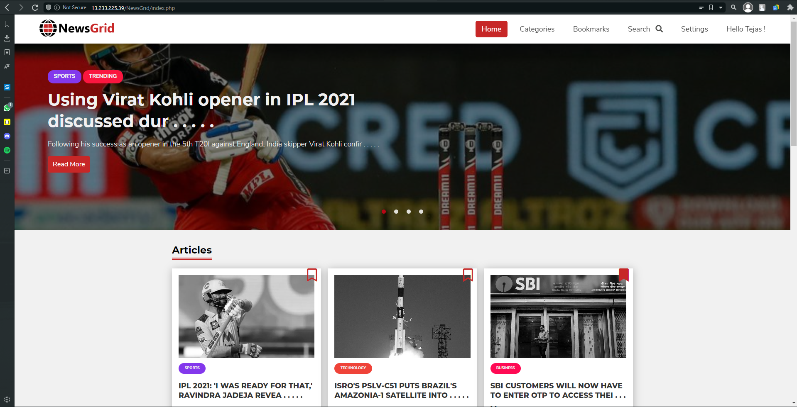
Index Page

Slide 7
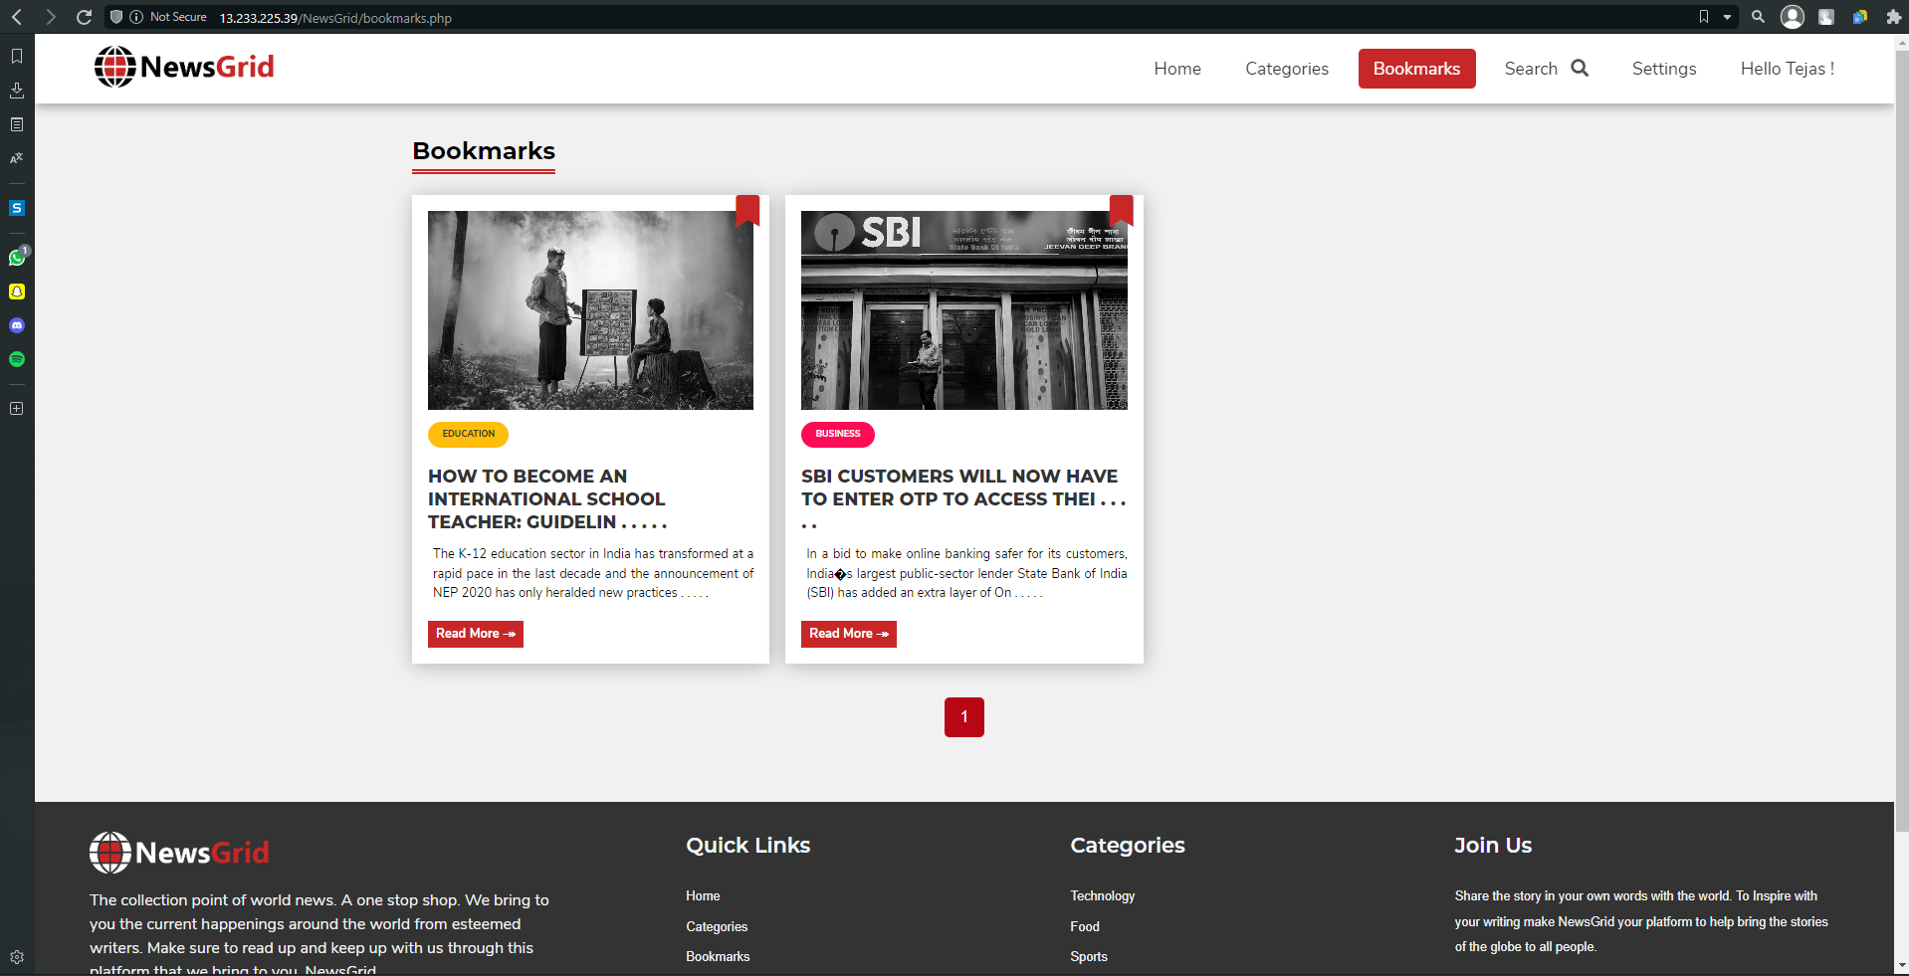
Bookmarks

Slide 8
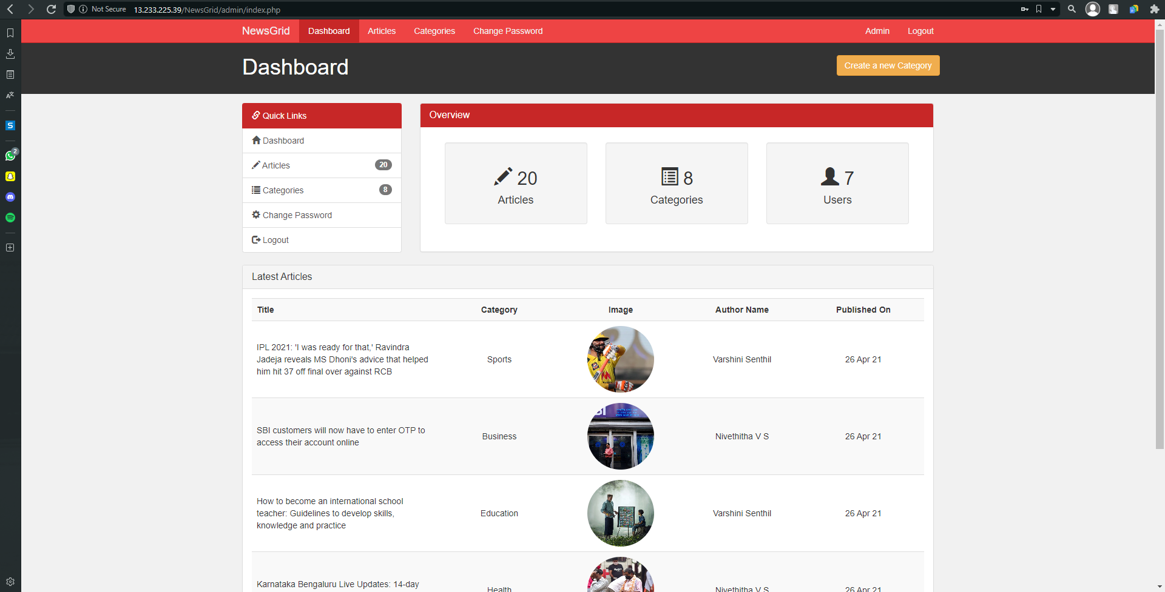
Admin Dashboard

Slide 9
THANK YOU

